Slide 1

World Cup Prediction Using Machine Learning and Python
Team Member: Cao Qinyu, Cui Xiaomei, Gong Chen, Li Chen,
Ning Yu, Wang Ruikun, Sun Dianyong, Tong Pai
Group Project for PKU Python Programming Summer School
Instructor: He Jibo

Slide 2


Introduction
Project Background
Like the previous FIFA World Cup 2014, the tournament in Russia has also caught the attention of several modelers who try to predict the tournament winner. (Leitner, Zeileis, and Hornik, 2010b, Zeileis, Leitner, and Hornik, 2012, 2014, 2016)
Existing approaches:
1. Poisson Regression Models
2. Ranking Methods
3. Tree-based Methods

Slide 3

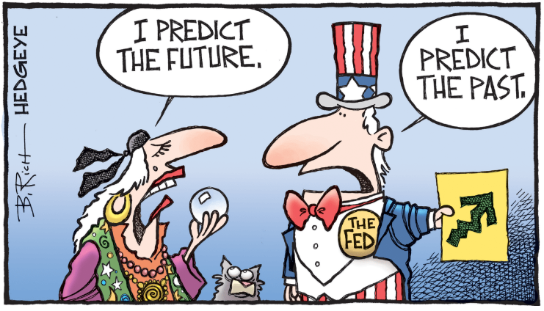
Introduction
Project Goal
Predict 2022 Qatar FIFA World Cup result. (Which team will likely to win in the Round 16, Quarter Finals, Semi-Finals, and Finals.)
Possible Application
Bet based on calculated probability
Show prediction ability to client
Practice Python programming

Slide 4
Contents
1
Existing Work
2
Data Collection & Visualization
3
Data Preprocessing (Feature Engineering)
4
Our Proposal: Machine Learning Method
5
Result Graph Presentation
6
Other Group Trials
7
Summary
Team Analysis

Slide 5
Contents
1
Existing Work
2
Data Collection & Visualization
3
Data Preprocessing (Feature Engineering)
4
Our Proposal: Machine Learning Method
5
Result Graph Presentation
6
Other Group Trials
7
Summary
Source:

Slide 6
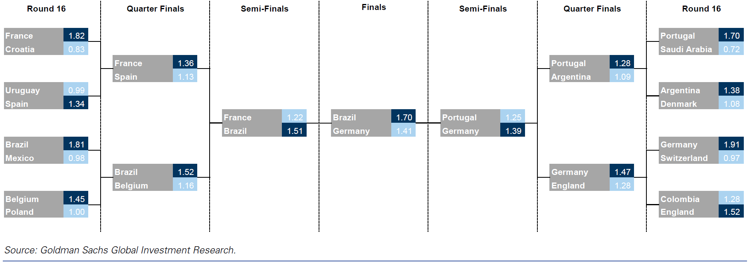

Existing Work
Investment Banks Really Like to Predict World Cups (2018)…
Goldman Sachs
Key Conclusion:
Brazil win the world cup
Russia cannot stand out from group stage
Germany will be in the final
Wrong!
Goldman Sachs Global Investment Research

Slide 7
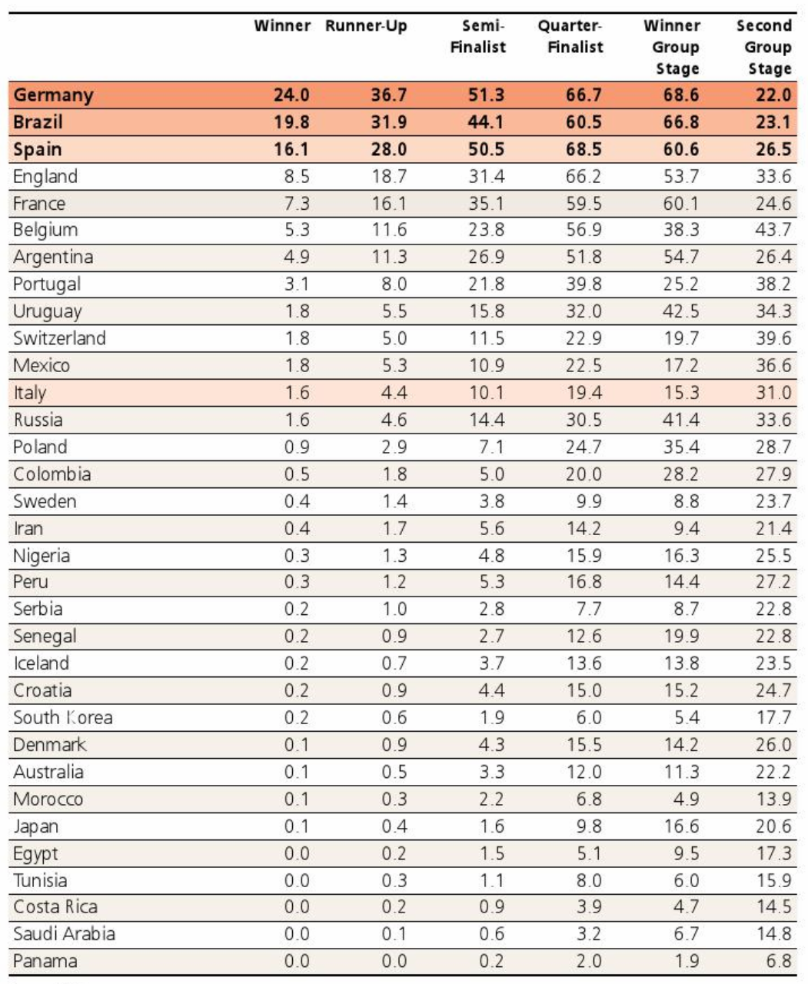
Existing Work
Investment Banks Really Like to Predict World Cups (2018)…
Union Bank of Switzerland
Key Conclusion:
Germany win the world cup
Brazil, Spain likely to be runner-up
Croatia is not likely to stand out from group stage
Wrong!
UBS Global Investment Research

Slide 8
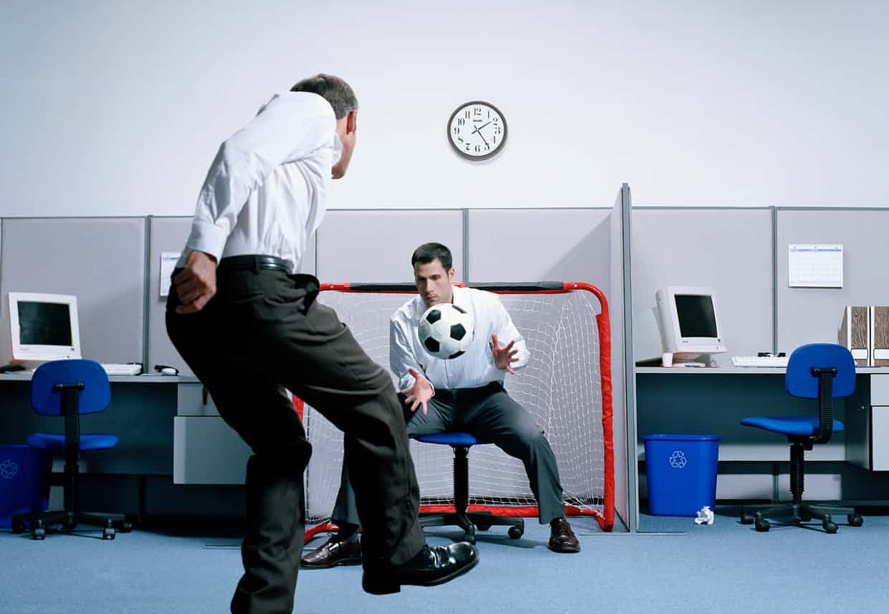
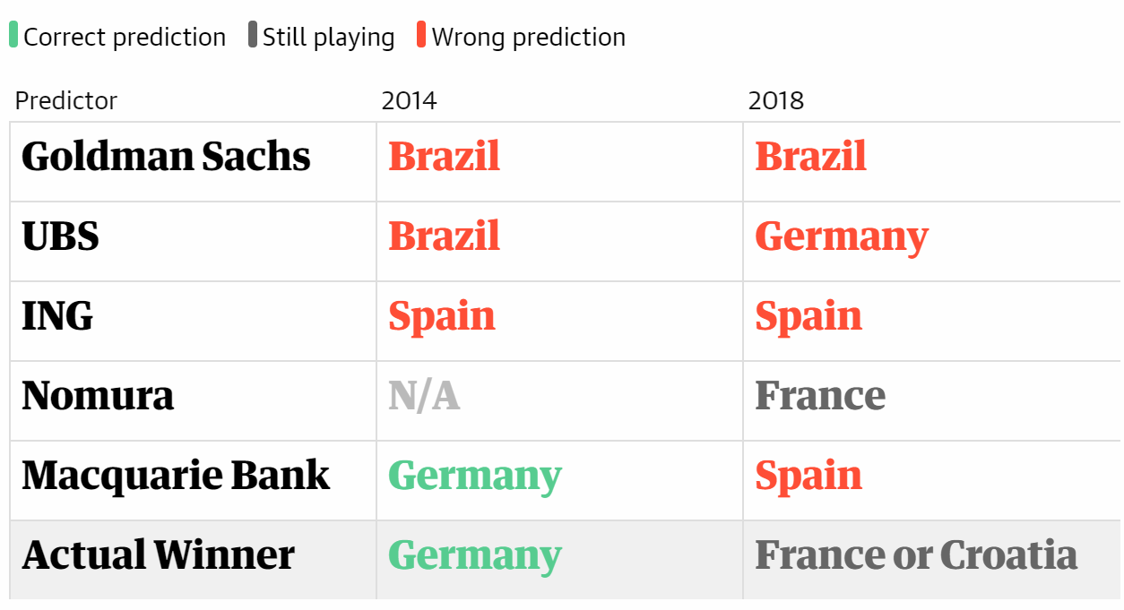
Existing Work
… But They Basically Get It Wrong
NOTE: Don’t believe in investment bank’s analysis; Believe in data and Python!
Team Analysis

Slide 9
Contents
1
Existing Work
2
Data Collection & Visualization
3
Data Preprocessing (Feature Engineering)
4
Our Proposal: Machine Learning Method
5
Result Graph Presentation
6
Other Group Trials
7
Summary
Source:

Slide 10
Data Collection
Collected Data from Various Dimension
Dataset Description
Data | Explanation
Major football tournament data from 1930 to 2018 | Including World Cup, World Cup qualification, regional championship et al.
World Cup ranking data from 1930 to 2018 | Including each team’s rank in the history of World Cup
Political, Economic, climate data | Auxiliary data.
GDP
GDP per capita
Household Consumption
PMI
Prosperity Index
M1
M2
10-year Treasury Bond Yield
Unemployment Rate
CPI
PPI
GDP Growth
Etc…
Kaggle, World Bank

Slide 11
Initial Data Visualization
Graph Representation and Interpretation
Graph Representation
Task 1:
Find out how many games each team won and show the result in a bar chart.
The top five teams are Germany, Argentina, Brazil, France and Spain.
Team Analysis

Slide 12
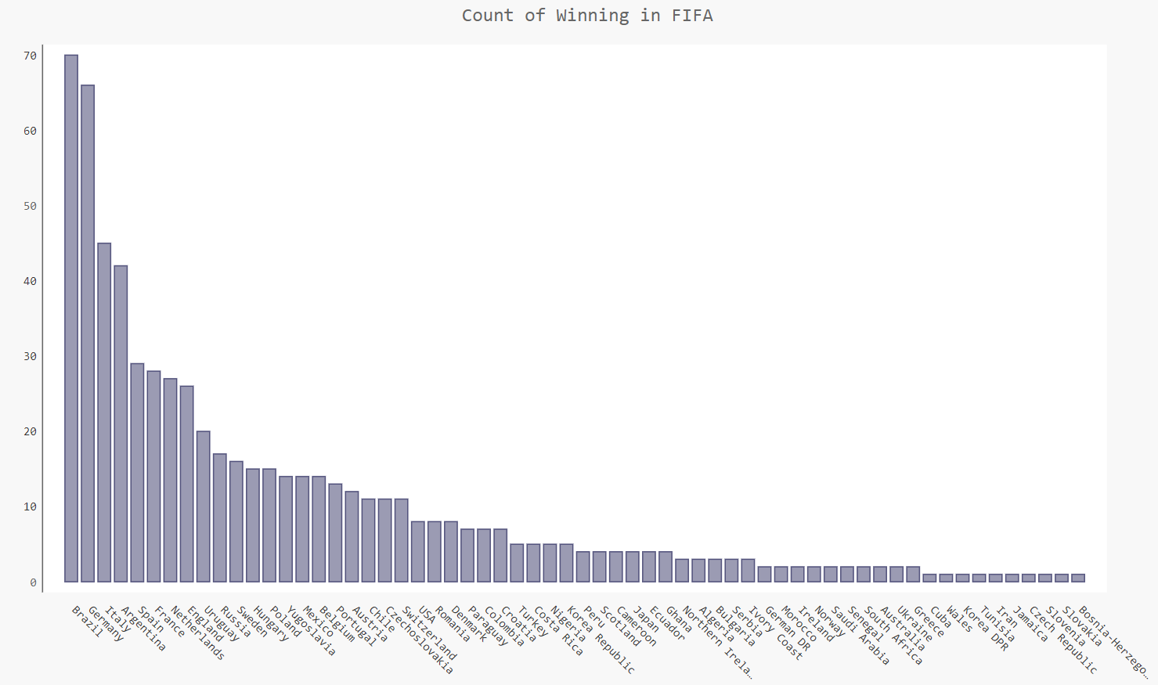
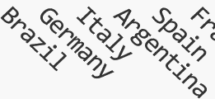
Initial Data Visualization
Graph Representation and Interpretation
Graph Representation
Team Analysis

Slide 13
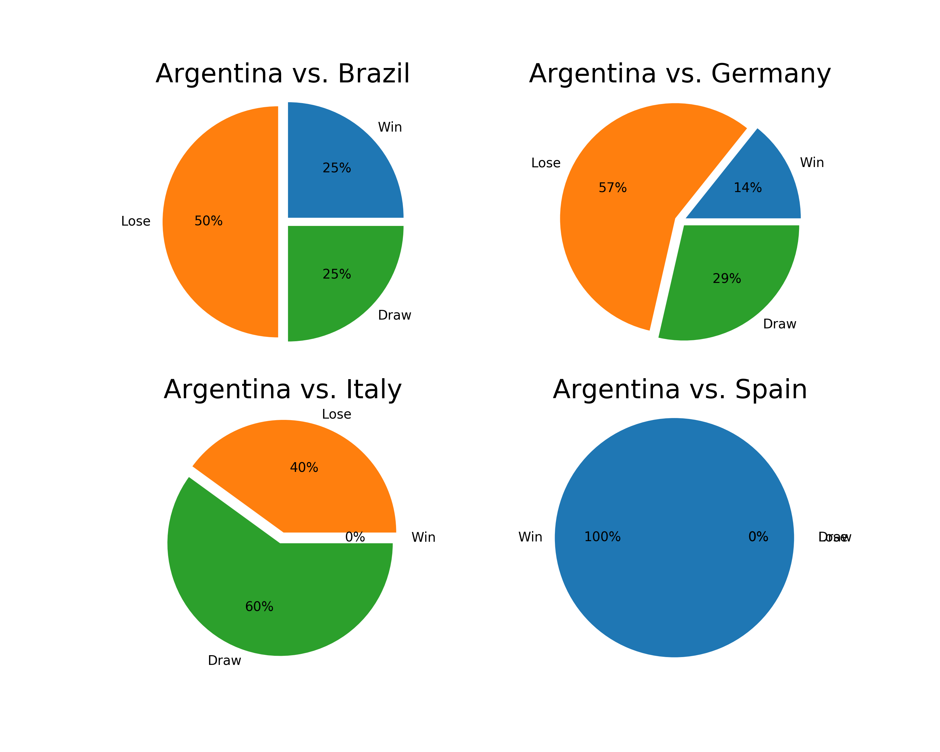
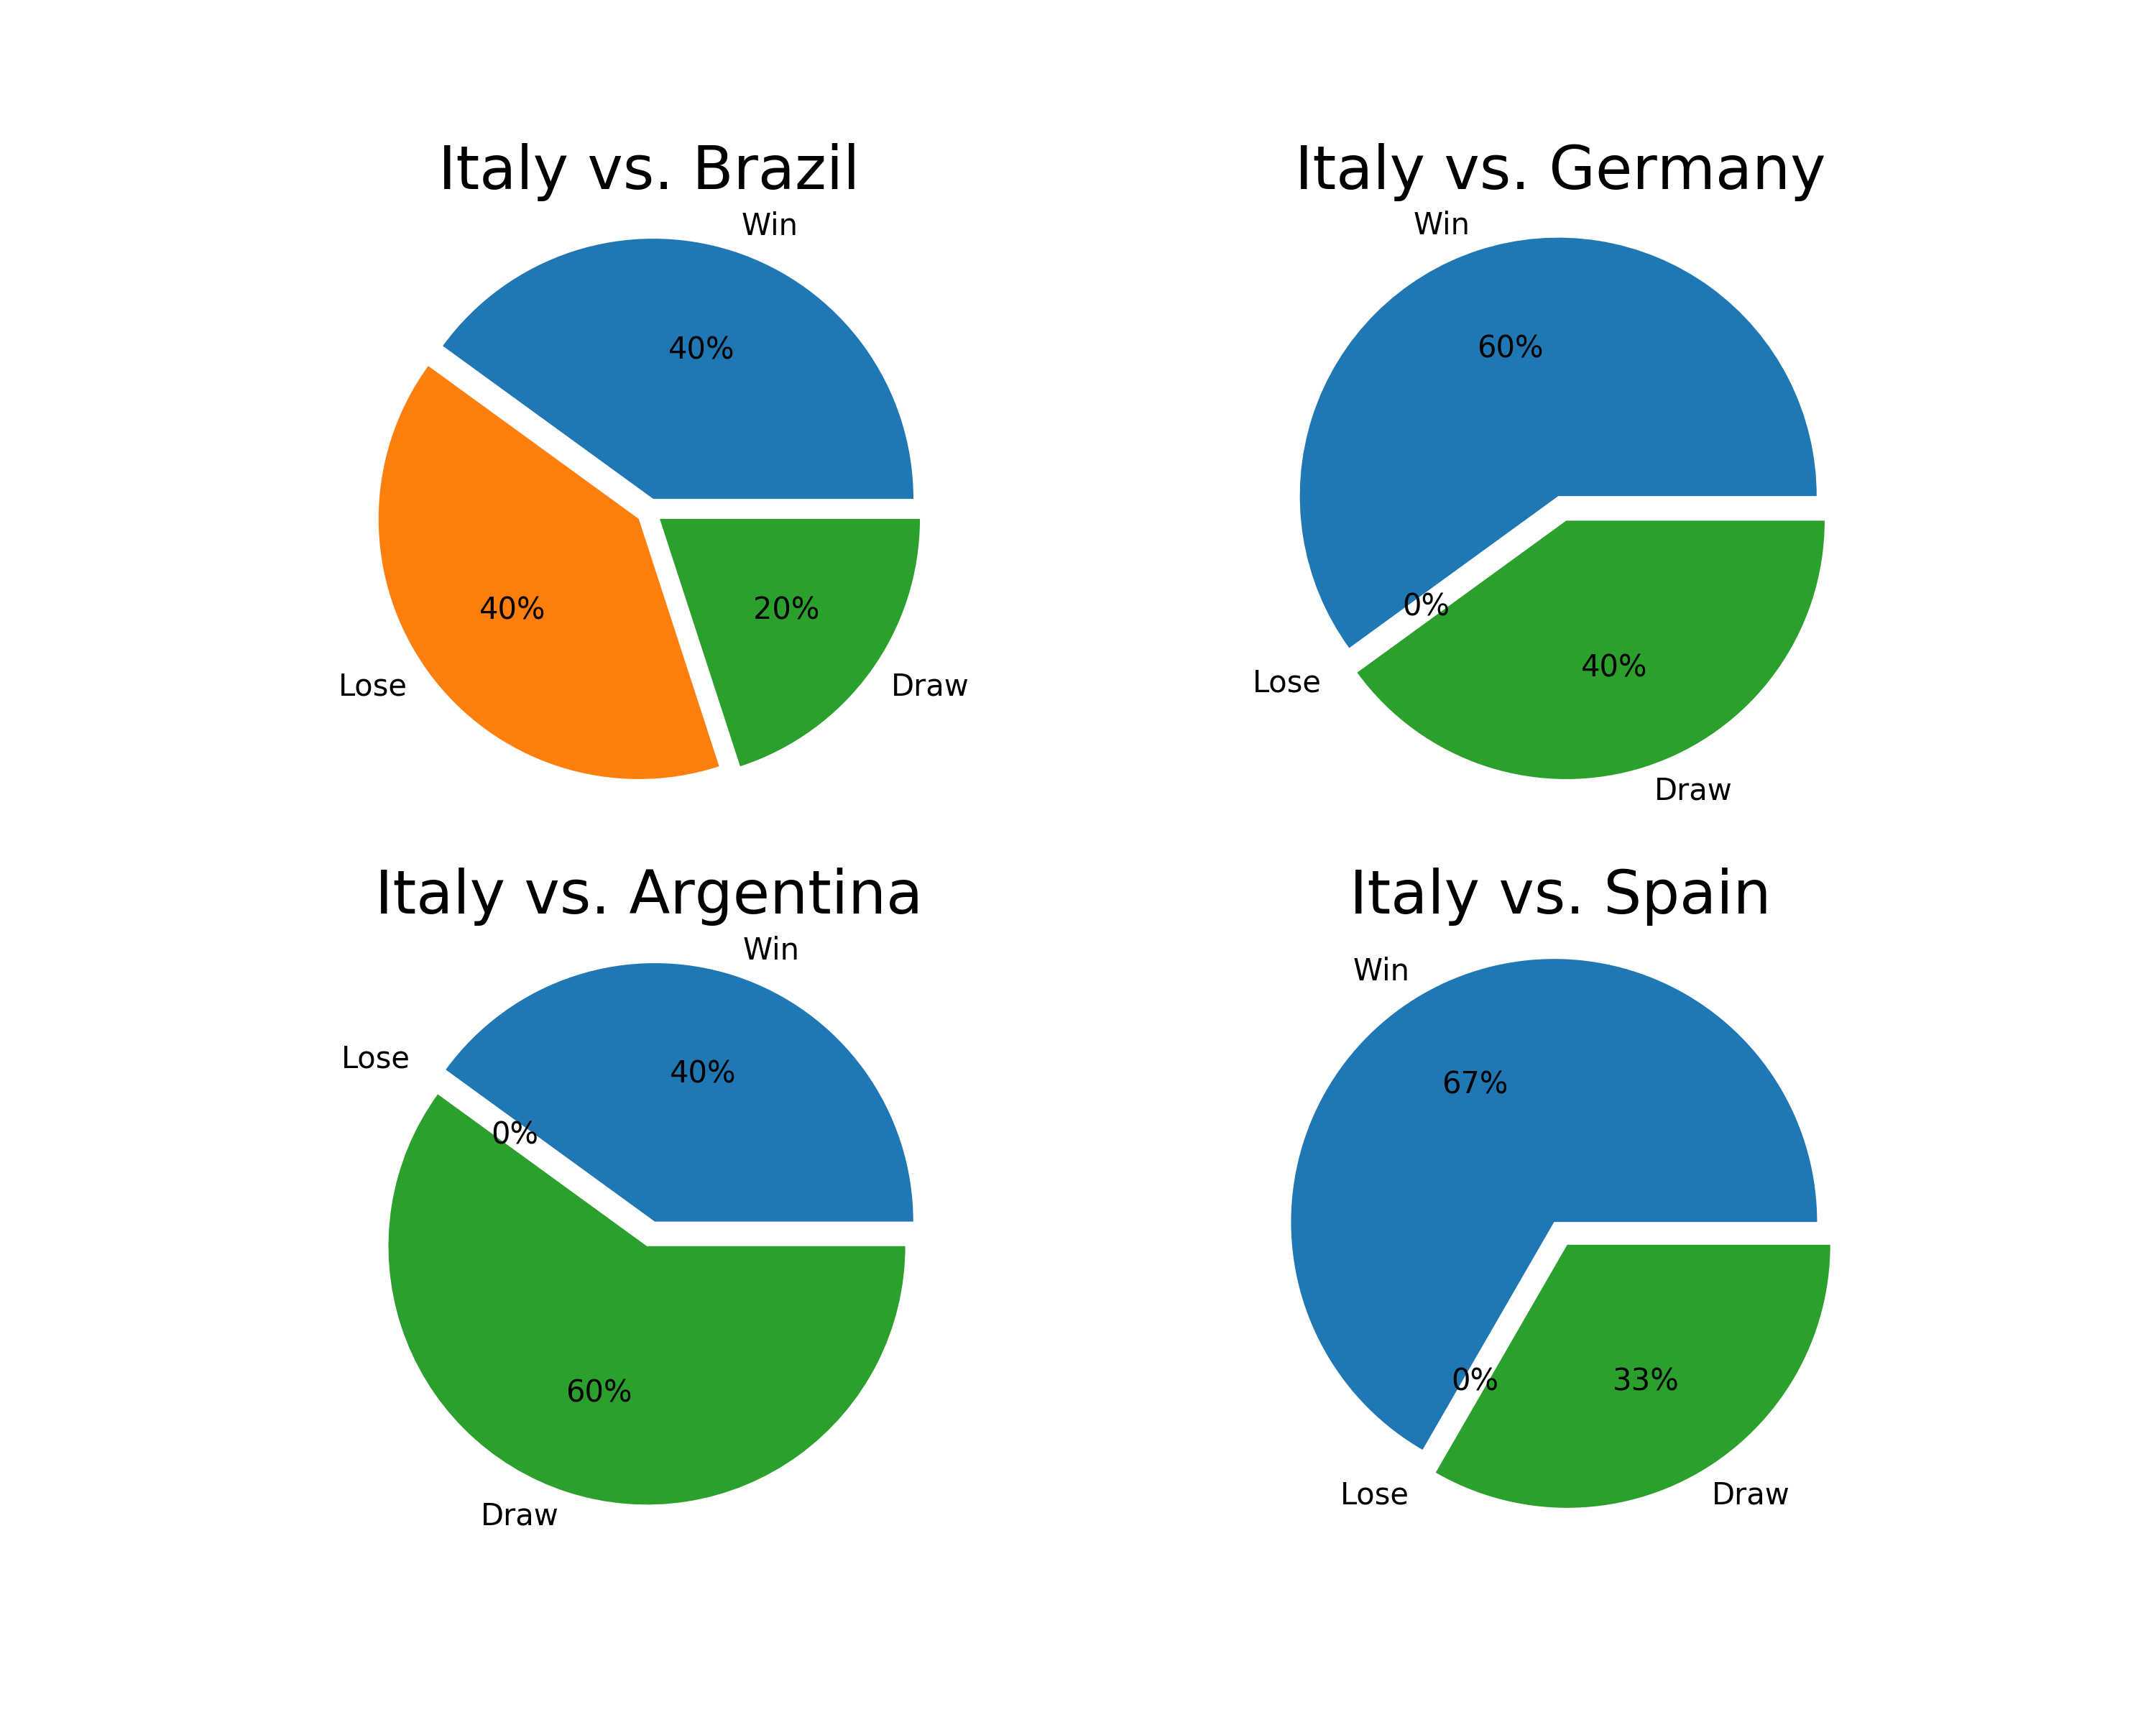
Initial Data Visualization
Graph Representation and Interpretation
Graph Representation
Task 2:
Find out the matches between the top five teams in World Cup.
Interesting note: Argentina always win over Spain in the World Cup history.
Team Analysis

Slide 14
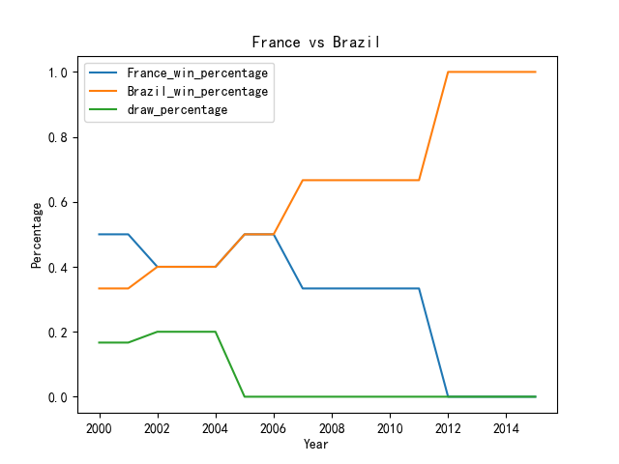
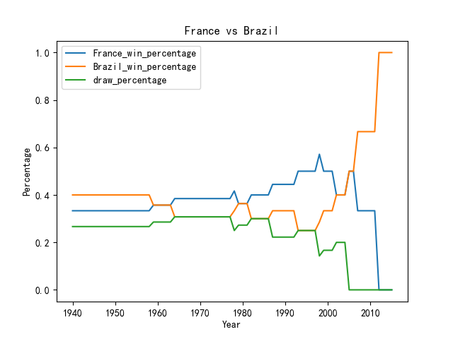
Initial Data Visualization
Graph Representation and Interpretation
Graph Representation
Task 3:
Find out the winning percentage between arbitrary two teams in the given interval.
Team Analysis

Slide 15
Contents
1
Existing Work
2
Data Collection & Visualization
3
Data Preprocessing (Feature Engineering)
4
Our Proposal: Machine Learning Method
5
Result Graph Presentation
6
Other Group Trials
7
Summary
Source:

Slide 16
Data Preprocessing (Feature Engineering)
Tree-Based Representation of Game
Example
Brazil
Italy
Sweden
Mexico
Peru
Morocco
Romania
Germany
Belgium
Uruguay
England
Bulgaria
Czechoslovakia
Israel
Russia
El Salvador
Third Place
Second Place
Champion
Team Analysis

Slide 17
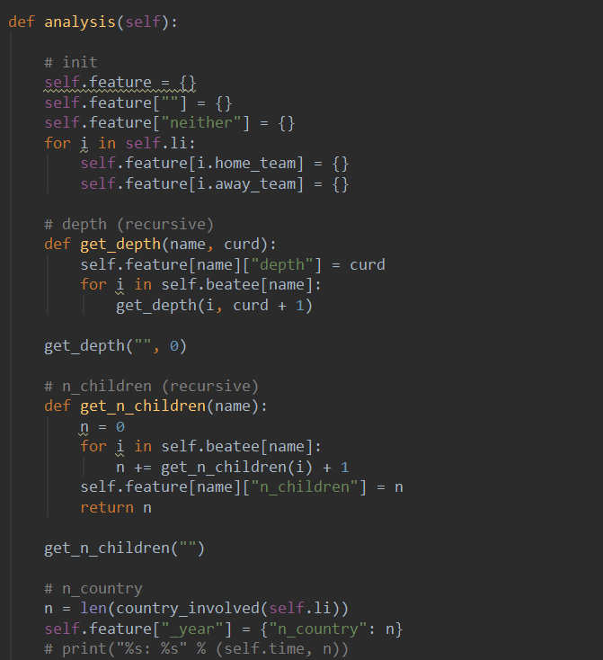
Data Preprocessing (Feature Engineering)
Tree-Based Features
Details
Further Explanation:
We made the annual situation of the game into the shape of a tree. The father of each node is the team that defeated itself.
For example, Germany was defeated by Italy, Italy was defeated by Brazil, and Brazil was the champion.
Extract some features from it, such as depth, number of descendants, etc.
Team Analysis

Slide 18
Contents
1
Existing Work
2
Data Collection & Visualization
3
Data Preprocessing (Feature Engineering)
4
Our Proposal: Machine Learning Method
5
Result Graph Presentation
6
Other Group Trials
7
Summary
Source:

Slide 19


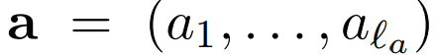
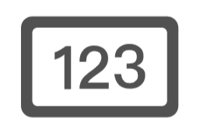

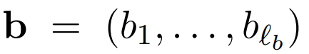

Our Proposal: Machine Learning Method
Model Input and Output
Approach Overview
Win
Draw
Various Dimension Data
Machine
Learning
Model
Output Prediction
Lose
Core of work
Team Analysis

Slide 20
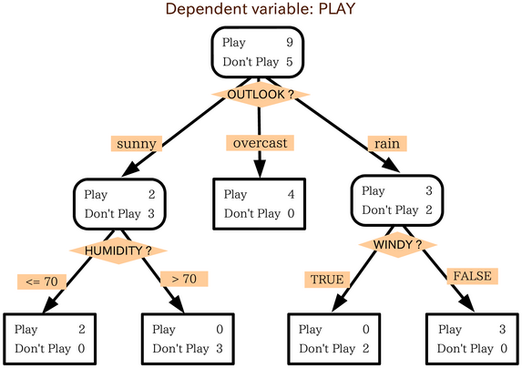
Our Proposal: Machine Learning Method
Multi-Grained Cascade Forest
Introduction
An example:
According to environmental variables, we want to predict whether or not to play golf.
The parameters here are all learned during the training process, and if the number of layers and the number of branches are much larger, complex problems can be predicted.
Team Analysis

Slide 21
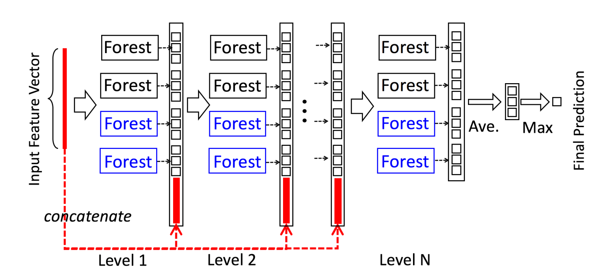
Our Proposal: Machine Learning Method
Multi-Grained Cascade Forest
Further Illustration
Multiple trees with different parameters form a random forest, and the output of random forests is determined by all trees.
The output of the random forest is regarded as the extraction of the input features, and iteratively continues, which is the meaning of the cascade.
Team Analysis

Slide 22
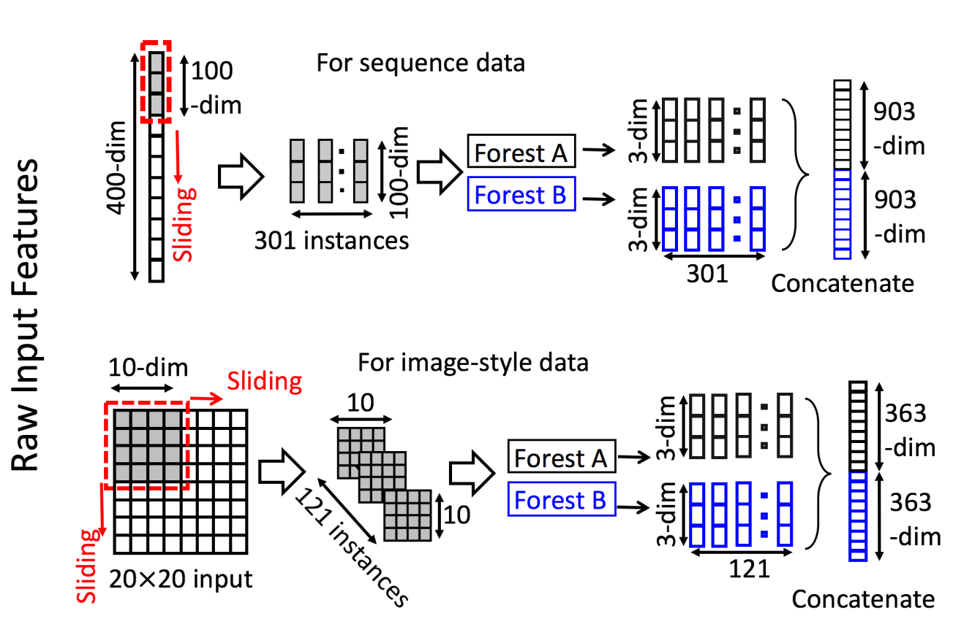
Our Proposal: Machine Learning Method
Multi-Grained Cascade Forest
Further Illustration
At the same time, we will sample the input multiple times, such as 400-dimensional input, and take every 100 consecutive dimensions to get 301 new instances.
This sampling can better identify the connections between the data, which is good for prediction.
Team Analysis

Slide 23
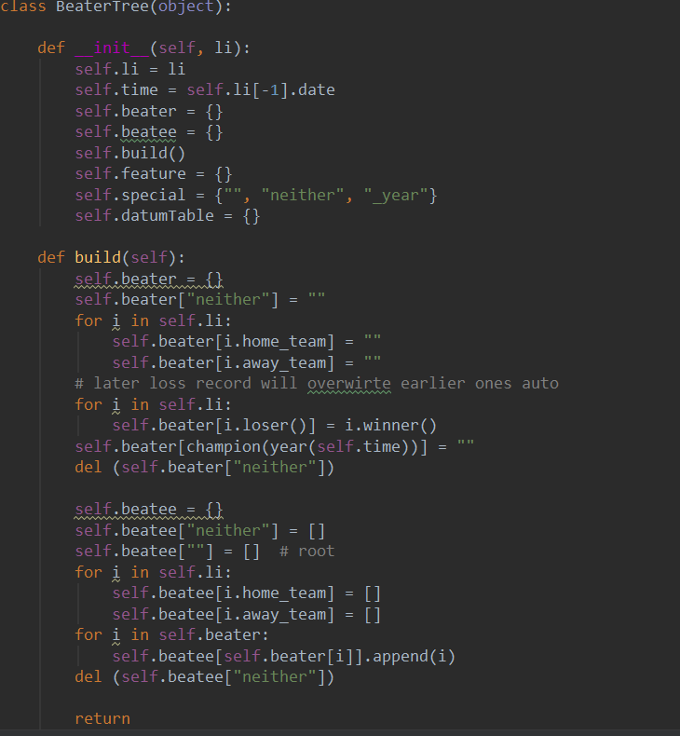
Our Proposal: Machine Learning Method
Multi-Grained Cascade Forest
Python Code
Team Analysis

Slide 24
Contents
1
Existing Work
2
Data Collection & Visualization
3
Data Preprocessing (Feature Engineering)
4
Our Proposal: Machine Learning Method
5
Result Graph Presentation
6
Other Group Trials
7
Summary
Source:

Slide 25
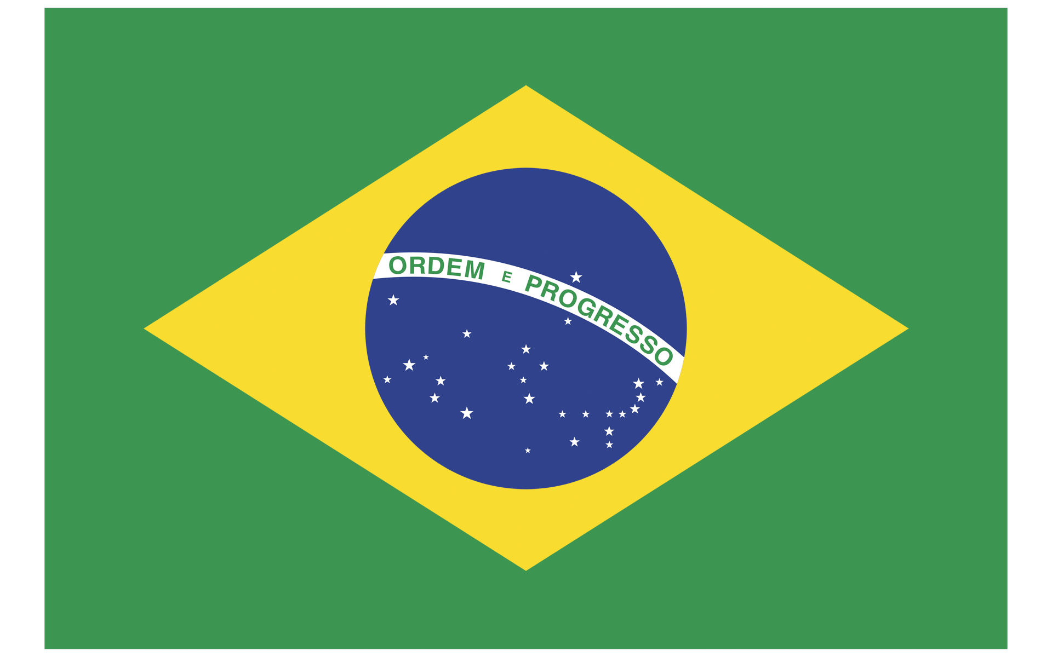

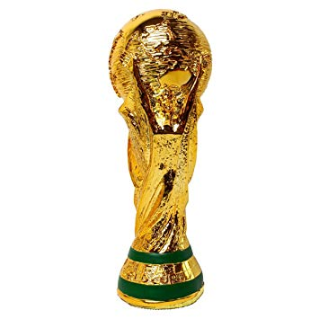


Result Graph Presentation
2022 Qatar World Cup Prediction
Graph Representation
Champion
Second Place
Third Place
Team Analysis

Slide 26
Contents
1
Existing Work
2
Data Collection & Visualization
3
Data Preprocessing (Feature Engineering)
4
Our Proposal: Machine Learning Method
5
Result Graph Presentation
6
Other Group Trials
7
Summary
Source:

Slide 27


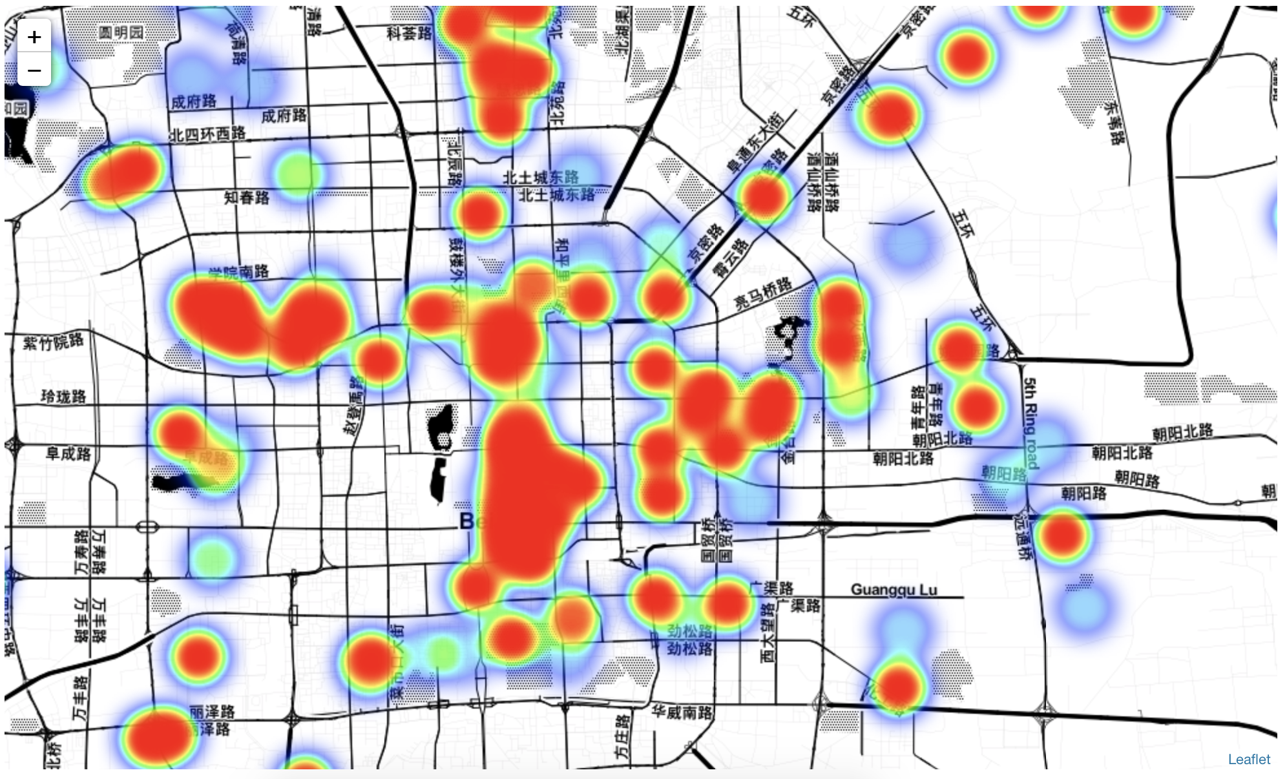
Other Group Trials
Everything worthwhile takes time and commitment.
Group Brainstorm of Several Topics to Try
We failed many times, finally arrived at this work…
Crawler of “Arena of Valor”
Machine learning based on weather data crawler
Beijing travel ticket prices (Succeeded)
It is our great pleasure to have met Professor He Jibo and all of you here @PKU!
Team Analysis

Slide 28
Contents
1
Existing Work
2
Data Collection
3
Data Preprocessing (Feature Engineering)
4
Our Proposal: Machine Learning Method
5
Result Graph Presentation
6
Other Group Trials
7
Summary
Source:

Slide 29
Contents
1
Existing Work
2
Data Collection
3
Data Preprocessing (Feature Engineering)
4
Our Proposal: Machine Learning Method
5
Result Graph Presentation
6
Other Group Trials
7
Summary
Source:

Slide 30
References
Goodfellow, Y. Bengio, and A. Courville. Deep Learning. MIT Press, Cambridge, MA, 2016.
H. Mhaskar, Q. Liao, and T. A. Poggio. When and why are deep networks better thanshallow ones? In Proceedings of the 31st AAAI Conference on Artificial Intelligence,pages 2343{2349, San Francisco, CA, 2017.
Zhou Z H, Feng J. Deep forest: Towards an alternative to deep neural networks[J]. arXiv preprint arXiv:1702.08835, 2017.
D. L. Richmond, D. Kainmueller, M. Y. Yang, E. W. Myers, and C. Rother. Relating cascaded random forests to deep convolutional neural networks for semantic segmentation. arXiv:1507.07583, 2015.
Source:

Slide 31
Scan QR code to get our Python code on GitHub!

Slide 32
Thank you!

